Slide 1
FINANCIAL ANALYTICS
PROJECT-2

Slide 2
INTRODUCTION
This data has the set of information on the market
capitalization of 500 companies in India.
We are using power bi tool for finding solutions for financial analytics data.

Slide 3
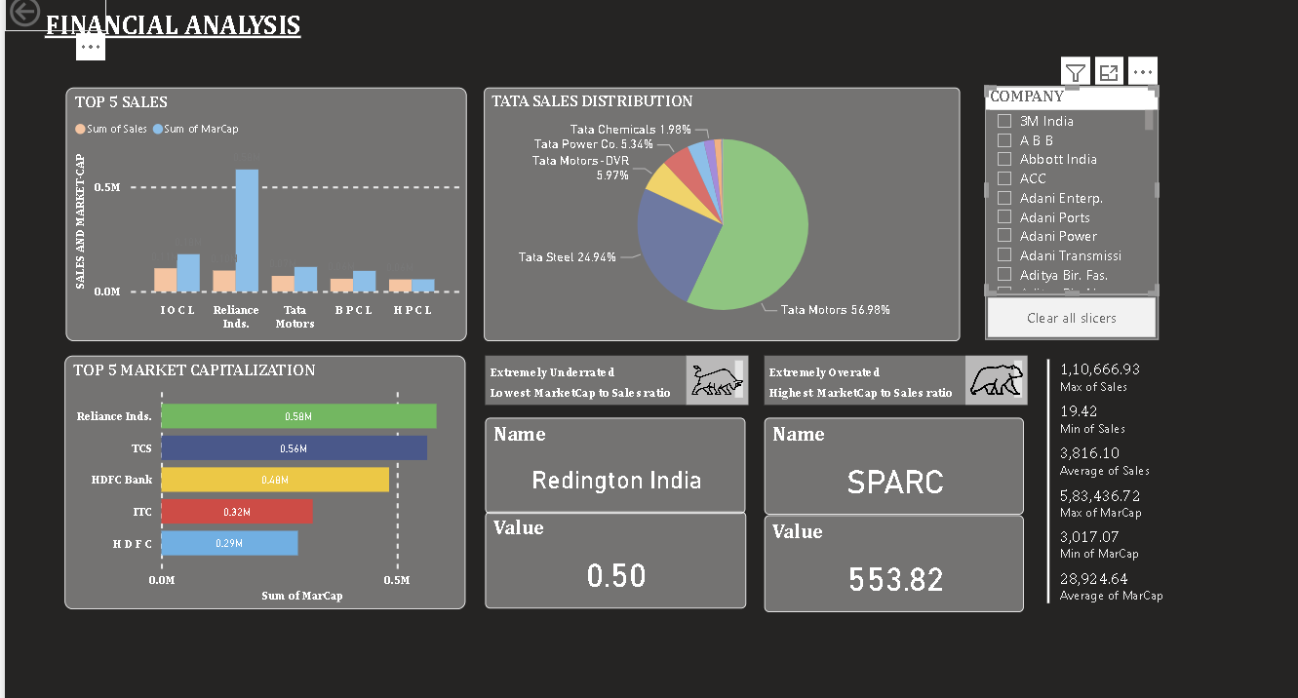
DASHBOARD

Slide 4
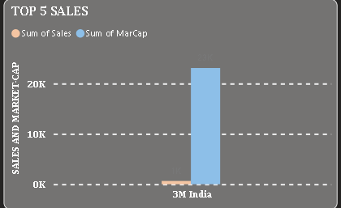
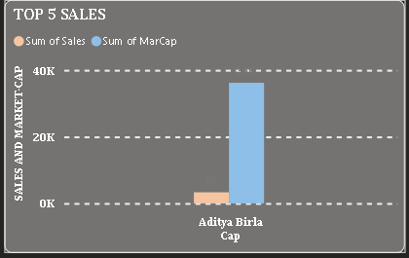
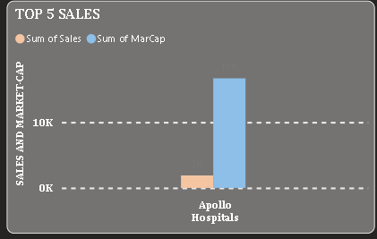
OBSERVATIONS
SALES AND MARKET- CAPITAL
3M INDIA
ADITYA BIRLA CAPITAL
APOLLO HOSPITAL

Slide 5


